Slide 1
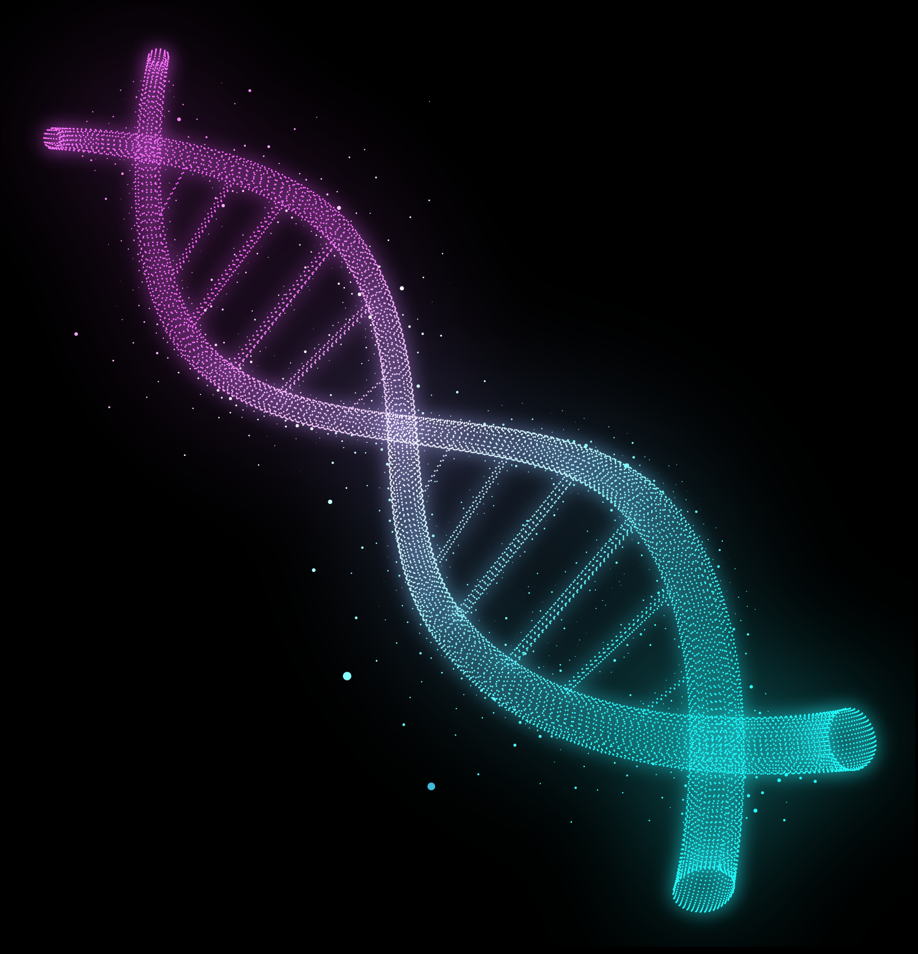

Bilkent University Spring 2025
CS481 Homework Assignment #5
A high-coverage Neandertal genome
from Vindija Cave in Croatia*
Deniz Tuna ONGUNER
22001788
*Prüfer, Kay, et al. “A high-coverage Neandertal genome from Vindija Cave in Croatia.” Science, vol. 358, no. 6363, 3
Nov. 2017, pp. 655–658, https://doi.org/10.1126/science.aao1887.

Slide 2

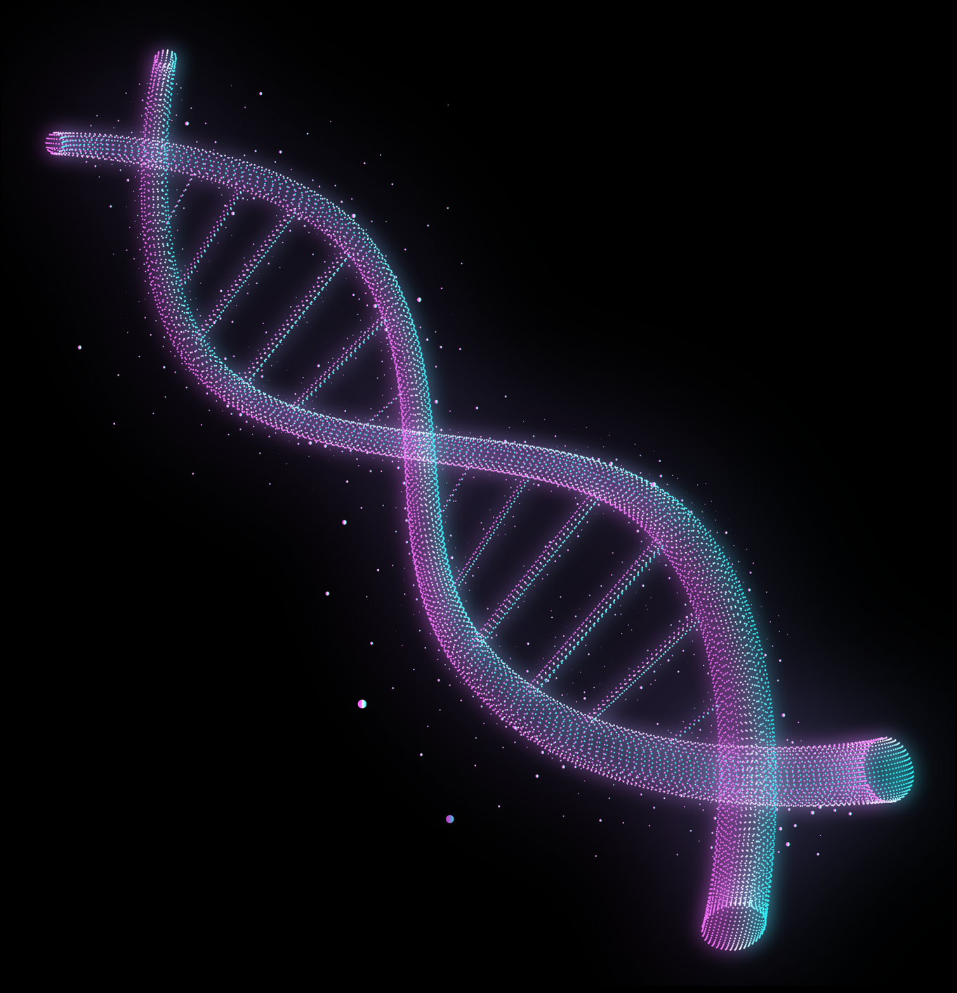
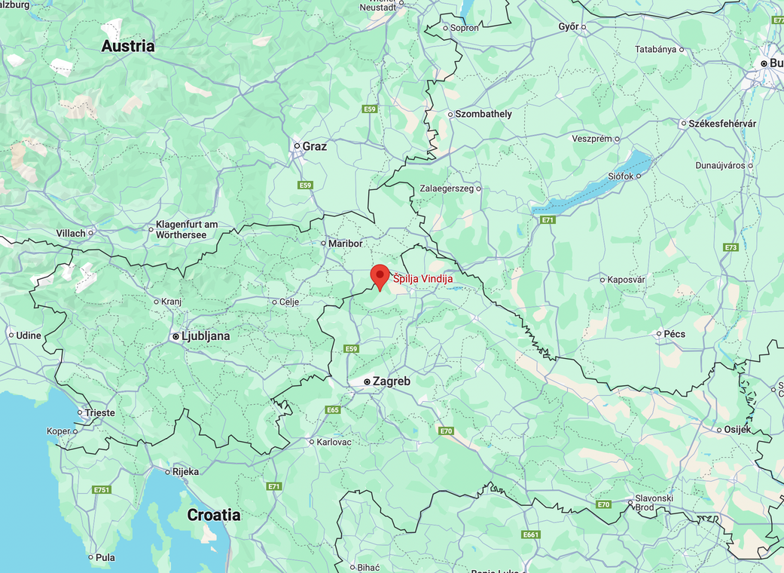
What the paper does – in one sentence
Sequenced a ~50 kyr‑old Neandertal femur (Vindija 33.19) to 30× depth, providing the first high‑quality European Neandertal genome and refining detection of Neandertal ancestry in modern humans [1].
Figure 1: Map of Vindija Cave, Croatia. Google Maps, 2025, maps.google.com.

Slide 3
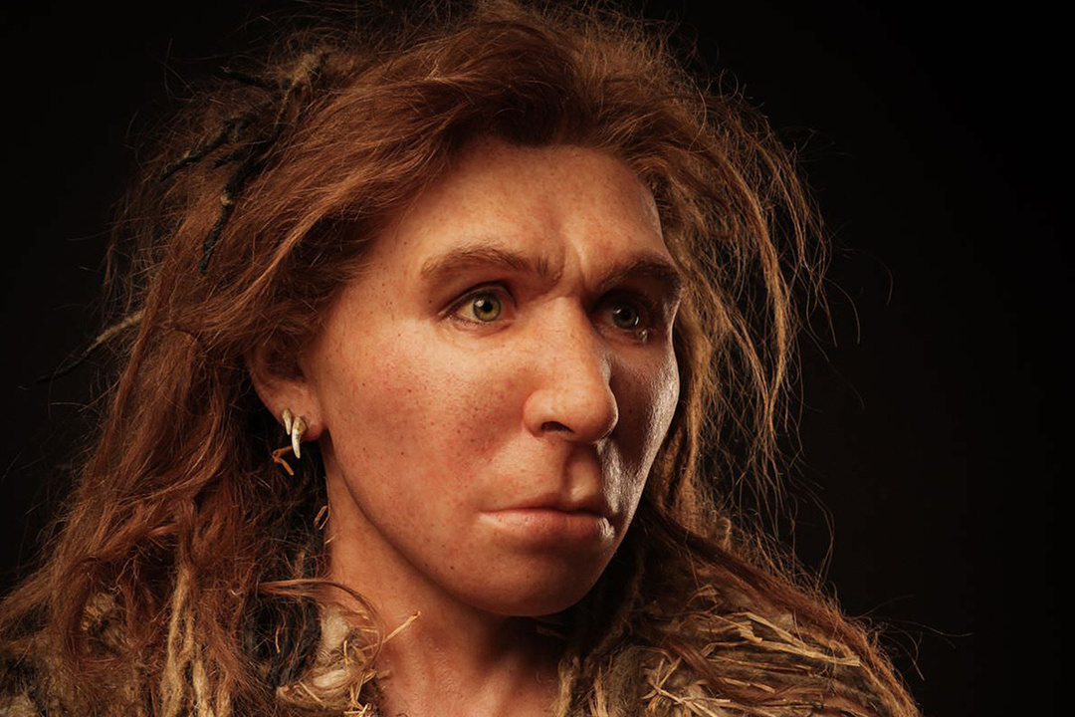
Background –
why this matters
Ancient DNA is scarce, damaged (<60 bp) and prone to contamination [1].
Before 2017 only one high‑coverage Neandertal genome (Altai, Siberia) existed [1].
Low‑resolution European data limited population‑genetic and bioinformatics analyses [1][2].
Figure 2: Neanderthal woman reconstruction (Saint-Césaire, France).
© S. Entressangle & É. Daynès / Reconstruction Atelier Daynès, Paris.

Slide 4
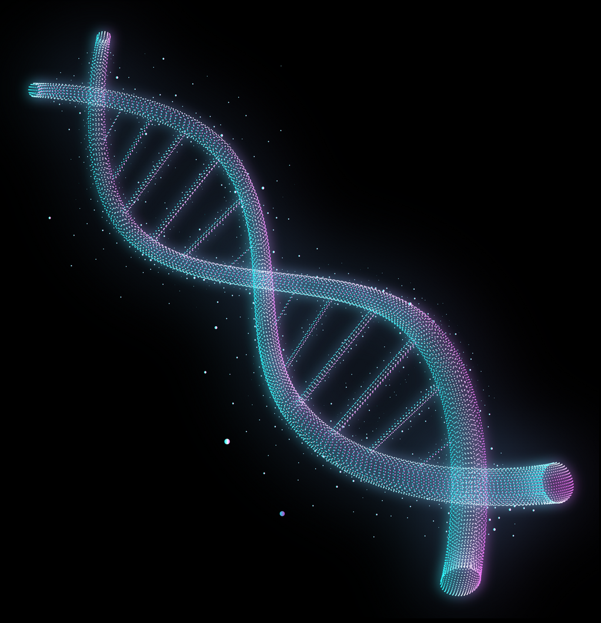




Sample & Chronology
Specimen: cortical bone fragment Vindija 33.19, Vindija Cave, Croatia [1].
Radiocarbon: >45.5 ka BP [1].
Excellent DNA preservation relative to other European Neandertals [1].

Slide 5
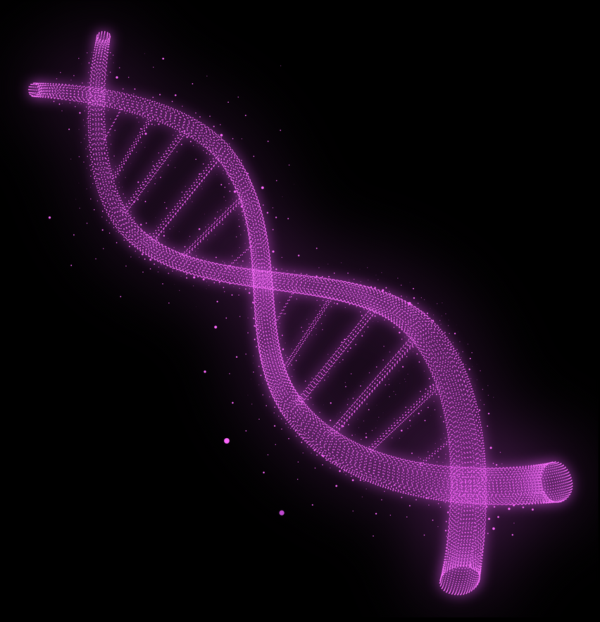




Wet‑lab Methods
Powder drilling; EDTA/Proteinase K extraction at low temperature to minimise depurination [1].
Constructed 12 double‑stranded Illumina libraries (mostly non‑UDG) to retain short, damaged molecules [1].
Generated 24 bn reads; 2.4 bn mapped to hg19 (~10 % endogenous) [1].

Slide 6

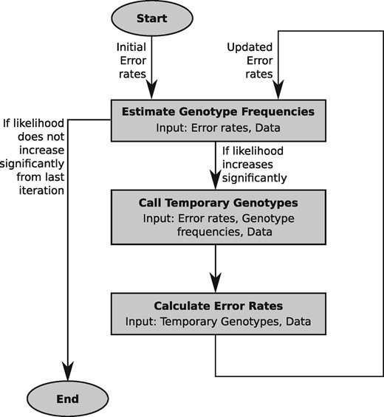
Bioinformatics Pipeline
Adapter‑trim & merge, map with BWA‑aln (seed disabled) [1].
Damage‑aware genotyping with snpAD [1].
Contamination estimates (mtDNA, X‑chromosome, ancestry‑SNPs) < 1 % [1].
High depth enabled indel and duplication discovery [1].
Figure 3: Schematic overview of the method implemented in snpAD [3]

Slide 7

~30-fold
coverage
About 10% of reads mapped to the human reference genome (hg19/GRCh37) [1]
~1.8 Gb
~53 bp
of genome sequence
of average read length

Slide 8



Results
Newly tagged alleles influence LDL cholesterol, immune traits, nicotine addiction, schizophrenia risk [1].
Neandertal‑specific duplications found in olfactory‑receptor clusters [1].
Created a public catalogue of ~4 million Neandertal SNPs [1].

Slide 9





Applications in Bioinformatics
Benchmarking damage‑aware aligners (nf‑core/eager, PALEOMIX) [1].
Improved introgression detection (IBDmix, Sprime, IBIS) [1].
Functional annotation in Ensembl VEP and PharmGKB [1].
Edge genome in human pangenome graphs [1].
Training data for ML base‑calling of ancient DNA [1].

Slide 10
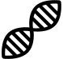


Scientific Impact
Enabled later high‑coverage genomes [2].
Core to Allen Ancient DNA Resource (AADR) [1].
Cited >2300 times; key to adaptive‑introgression debates [1].

Slide 11

THANKS
FOR WATCHING
CREDITS: This presentation template was created by Slidesgo, and includes icons by Flaticon and infographics & images by Freepik

Slide 12


REFERENCES
[1] Prüfer, Kay, et al. “A high-coverage Neandertal genome from Vindija Cave in
Croatia.” Science, vol. 358, no. 6363, 3 Nov. 2017, pp. 655–658, https://doi.org/10.1126/science.aao1887.
[2] Mafessoni, Fabrizio, et al. “A high-coverage Neandertal genome from
Chagyrskaya Cave.” Proceedings of the National Academy of Sciences, vol.
117, no. 26, 16 June 2020, pp. 15132–15136, https://doi.org/10.1073/pnas.2004944117.
[3] Prüfer, Kay. SNPAD: An Ancient DNA Genotype Caller, 24 Mar. 2018, https://doi.org/10.1101/288258.
[4] “Map Showing the Range of Neanderthals.” Brilliant Maps, 23 Sept. 2024,
brilliantmaps.com/range-of-neanderthals/.

